Slide 1
CAPSTONE PROJECT
HOTEL BOOKING ANALYSIS
AKHILA.V

Slide 2
Objective
The objective of this project is to analyse booking patterns, guest preferences, and factors influencing cancellations in the hotel industry. Using SQL and Excel, we will identify trends in booking sources, revenue, and other key metrics. Additionally, we aim to develop a Power BI dashboard for tracking booking trends and optimizing hotel operations.

Slide 3
Dashboard
Visualization

Slide 4
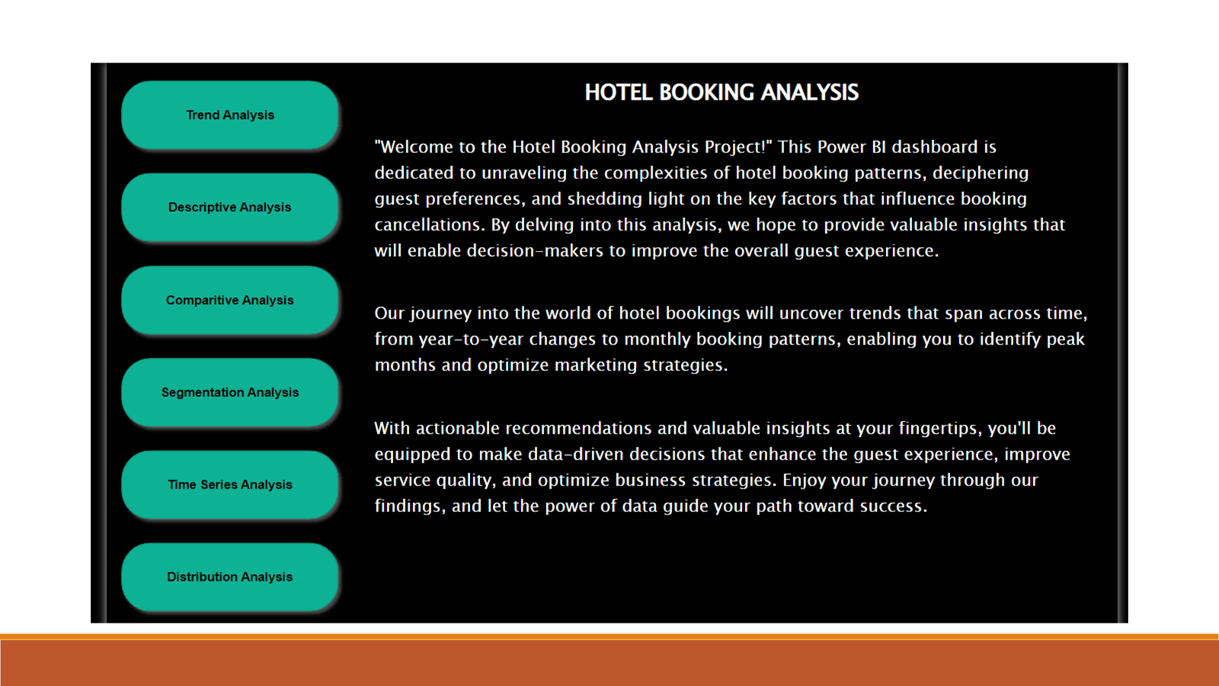
Home Page

Slide 5
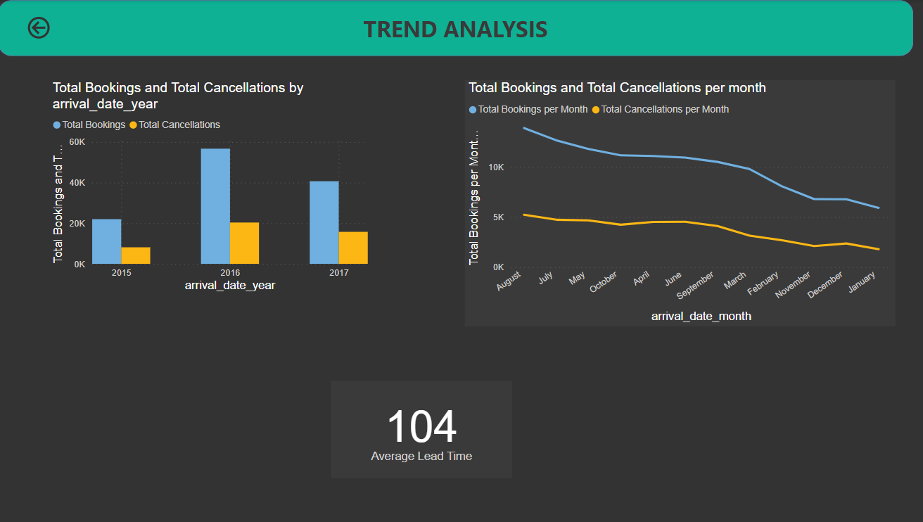

Slide 6
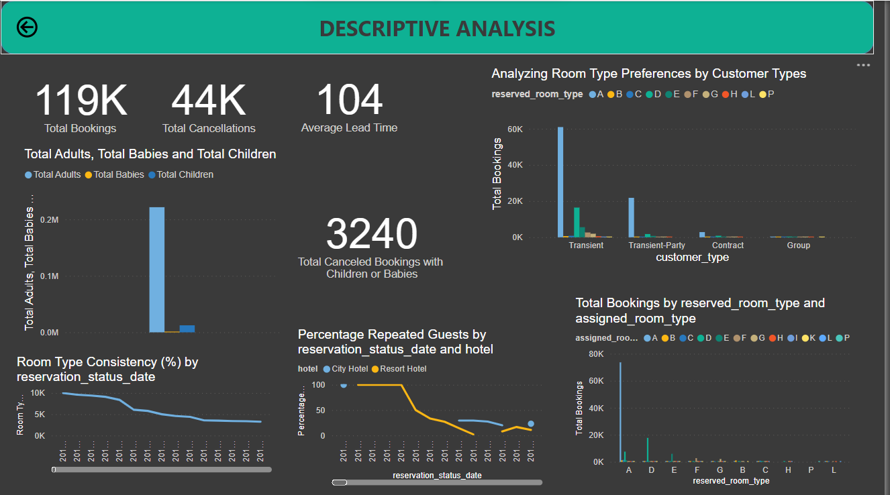

Slide 7
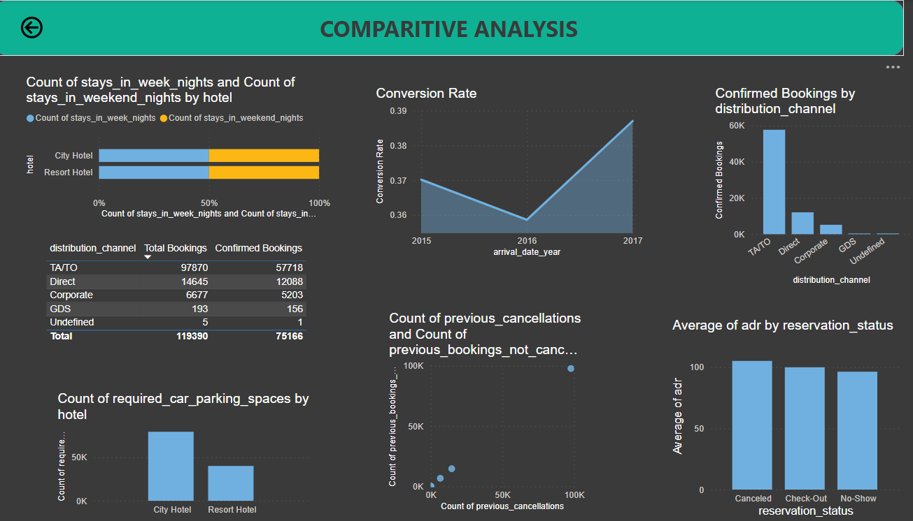

Slide 8
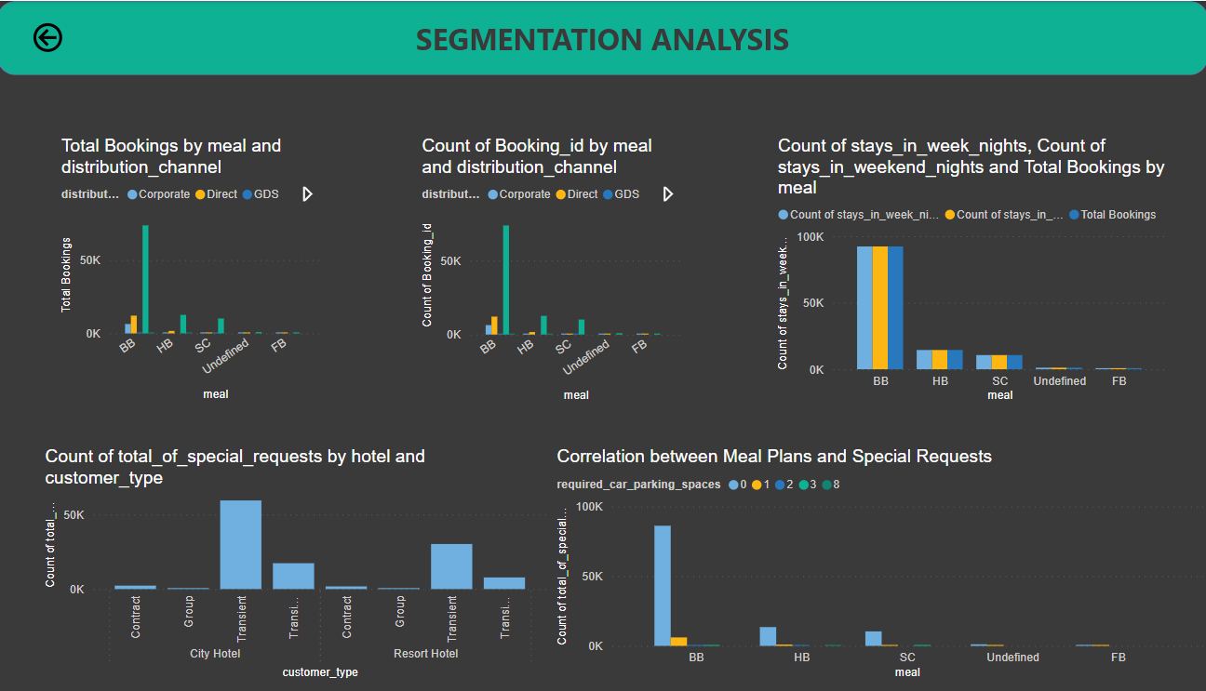

Slide 9
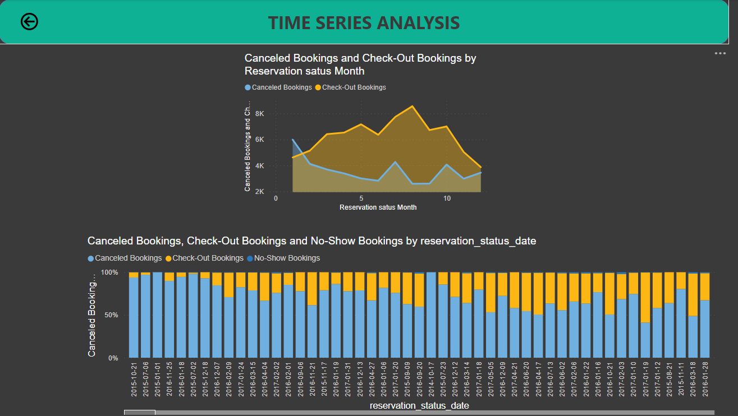

Slide 10
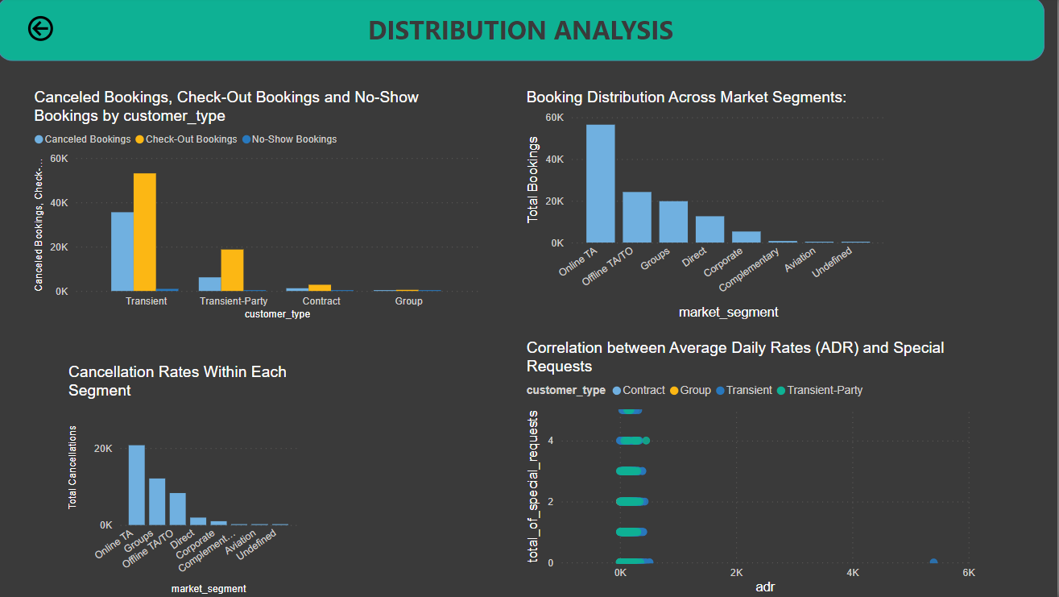

Slide 11
Insights derived from the conclusions:
1. Booking Trends Over the Years:
- A gradual increase in the total number of bookings and cancellations occurred from 2015 to 2017.
- The average lead time remained consistent at 104 days.
2. Stays in Weekend Nights and Weekday Nights:
- City hotels had more weekday and weekend stays compared to resort hotels.
3. Booking Conversion Rate Over Time:
- The highest conversion rate was in 2017, indicating improved booking outcomes.
4. ADR and Special Requests:
- "Transient" guests had a stronger correlation with special requests compared to other customer types.
5. Parking Requirements by Hotel Type:
- City hotels had higher parking space requirements than resort hotels.
6. Special Requests by Hotel and Customer Type:
- "Transient" guests in city hotels had the highest number of special requests.
7. Meal Plans and ADR:
- Bookings with meal plan "BB" had the highest total, followed by "HB" and "SC."
8. Meal Plan Distribution Across Booking Channels:
- "BB" meal plan with "TA/TO" channel had the highest total bookings.

Slide 12
11. Guest Retention:
- The percentage of repeated guests had variations over time for both city and resort hotels.
12. Booking History Impact on Cancellation:
- The "TA/TO" channel had the highest count of previous cancellations.
13. Reserved and Assigned Room Types:
- Room type "A" was the most common choice, with room type "P" being the least common.
14. Booking Changes and Cancellations:
- City hotels had more booking changes and canceled bookings compared to resort hotels.
15. Room Type Preferences by Customer Type:
- "Transient" and "Transient-Party" guests preferred room type "A."
16. Consistency in Room Type Preferences:
- Room type preferences were most consistent on 2015-06-17 and 2015-06-29, with the least consistency on 2015-04-25.
17. Reservation Status Overview:
- The dataset reflects the numbers of cancelled, checked-out, and no-show bookings on specific dates.
18. Trends in Reservation Status Dates:
- July was the busiest month for check-outs, and January had the highest number of cancellations.
19. Reservation Status by Customer Type:
- "Transient" guests were associated with a higher number of cancellations compared to other customer types.
20. ADR and Reservation Status:
- Cancelled bookings had a slightly higher ADR than check-out and no-show bookings.
These insights provide a comprehensive view of the hotel booking analysis project and can guide decision-making to enhance guest experiences and hotel operations.

Slide 13
Please see the document below for a much more detailed analysis and report that I prepared.

Slide 14
THANK YOU

